Slide 1
Chapter 5
Some Discrete Probability Distributions
Chapter 5
Some Discrete Probability Distributions

Slide 2
Chapter 5.1
Introduction
Introduction
Often, the observations generated by different statistical experiments have the same general type of behavior.
The discrete random variables associated with these experiments can be described by essentially the same probability distribution in a single formula.
In fact, one needs only a handful of important probability distributions to describe many of the discrete random variables encountered in practice.
In this chapter, we are going to present these commonly used distributions with various examples.

Slide 3
Chapter 5.2
Discrete Uniform Distribution
Discrete Uniform Distribution
If the random variable X assumes the values x₁, x₂, ..., x_{k}, with equal probabilities, then the discrete uniform distribution is given by
When a light bulb is selected at random from a box that contains a 40-watt bulb, a 60-watt bulb, a 75-watt bulb, and a 100-watt bulb, each element of the sample space S = {40, 60, 75, 100} occurs with probability 1/4.
Therefore, we have a uniform distribution, with

Slide 4
Chapter 5.2
Discrete Uniform Distribution
Discrete Uniform Distribution
When a dice is tossed, each element of the sample space S = {1, 2, 3, 4, 5, 6} occurs with probability 1/6.
Therefore, we have an uniform distribution with

Slide 5
Chapter 5.3
Binomial and Multinomial Distributions
Bernoulli Process
An experiment often consists of repeated trials, each with two possible outcomes that may be labeled success or failure. We may choose to define either outcome as a success.
The process is referred to as a Bernoulli process.
Each trial is called a Bernoulli trial.
Strictly speaking, the Bernoulli process must possess the following properties:
The experiment consists of n repeated trials.
Each trial results in an outcome that may be classified as a success or a failure.
The probability of success, denoted by p, remains constant from trial to trial.
The repeated trials are independent.

Slide 6
Chapter 5.3
Binomial and Multinomial Distributions
Bernoulli Process
Consider the set of Bernoulli trials where three items are selected at random from a manufacturing process, inspected, and classified defective or non-defective. A defective item is designated a success. The number of successes is a random variable X assuming integer values from 0 to 3.
The items are selected independently from a process and we shall assume that it produces 25% defectives.
The probability of the outcome NDN can be calculated as

Slide 7

Chapter 5.3
Binomial and Multinomial Distributions
Bernoulli Process
The probabilities for the other possible outcomes can also be calculated to result the probability distribution of X
The number X of successes in n Bernoulli trials is called a binomial random variable.
The probability distribution of this discrete random variable is called the binomial distribution, and denoted by b(x; n, p).

Slide 8
Chapter 5.3
Binomial and Multinomial Distributions
Binomial Distribution
|Binomial Distribution| A Bernoulli trial can result in a success with probability p and a failure with probability q = 1 – p. Then the probability distribution of the binomial random variable X, the number of successes in n independent trials, is
The mean and variance of the binomial distribution b(x; n, p) are
The probability that a certain kind of component will survive a given shock test is 3/4. Find the probability that exactly 2 of the next 4 components tested will survive.

Slide 9
Chapter 5.3
Binomial and Multinomial Distributions
Binomial and Multinomial Distributions
The probability that a patient recovers from a rare blood disease is 0.4. If 15 people are known to have contracted this disease, what is the probability that (a) at least 10 survive, (b) from 3 to 8 survive, and (c) exactly 5 survive?
Let X be the number of people that survive. Table A.1 gives help.
?
Can you calculate manually?

Slide 10
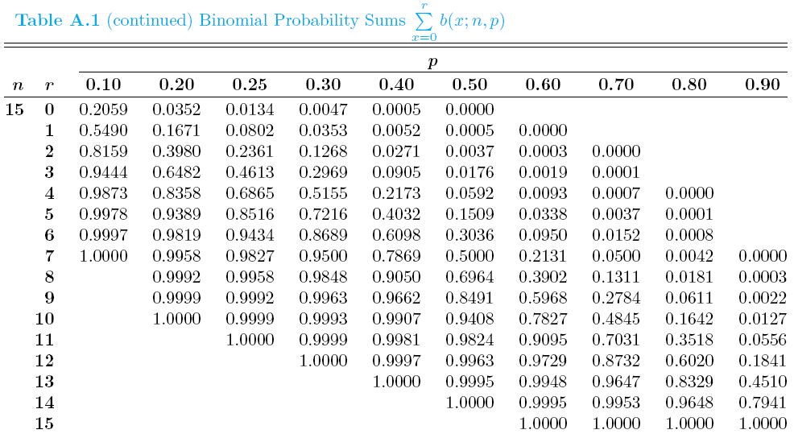
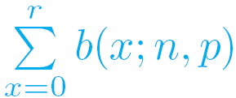
Chapter 5.3
Binomial and Multinomial Distributions
Table A.1 Binomial Probability Sums

